Slide 1

Muscle Identification Practice

Slide 2
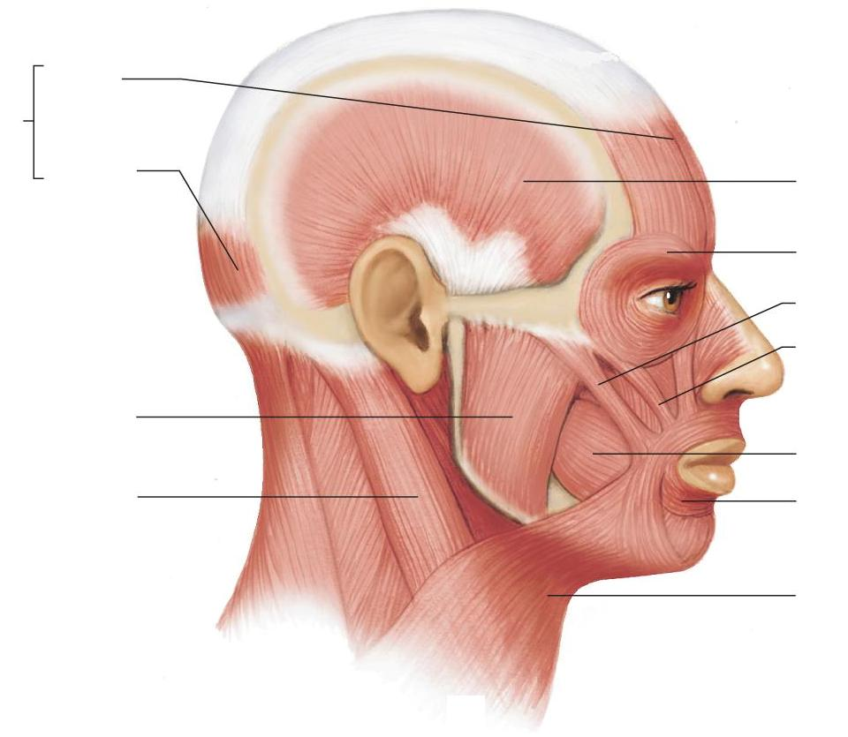
Frontalis
Epicranius
Occipitalis
Temporalis
Orbicularis oculi
Zygomaticus major
Zygomaticus minor
Masseter
Buccinator
Sternocleidomastoid
Orbicularis oris
Platysma

Slide 3
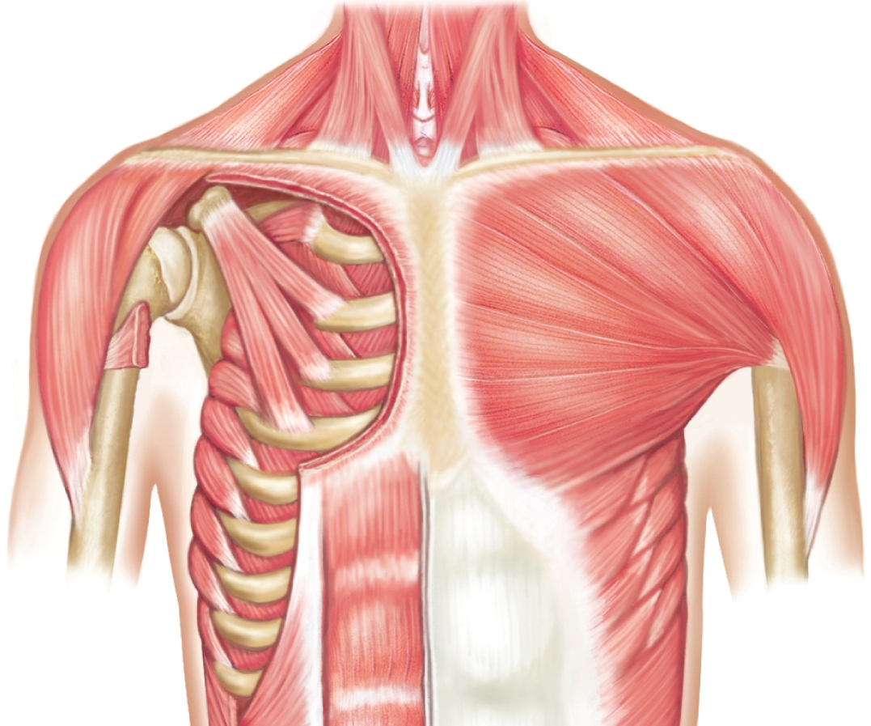
Pectoralis minor
Pectoralis major
Serratus anterior

Slide 4
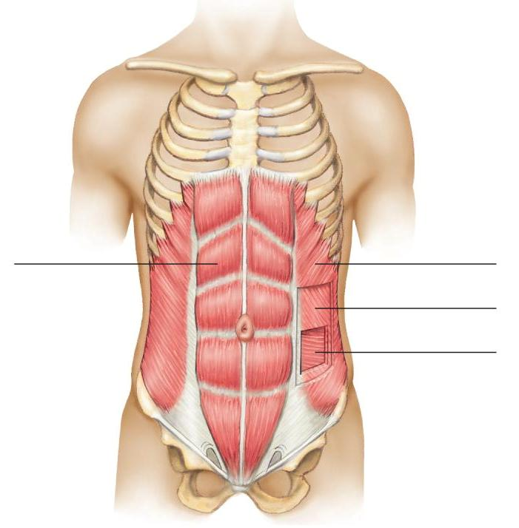
External oblique
Rectus abdominis
Internal oblique
Transversus abdominis

Slide 5
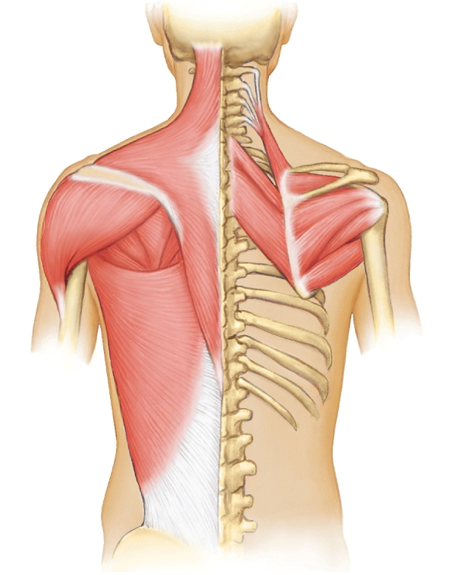
Trapezius
Levator scapulae
Deltoid
Rhomboid minor
Infraspinatus
Latissimus dorsi
Rhomboid major

Slide 6
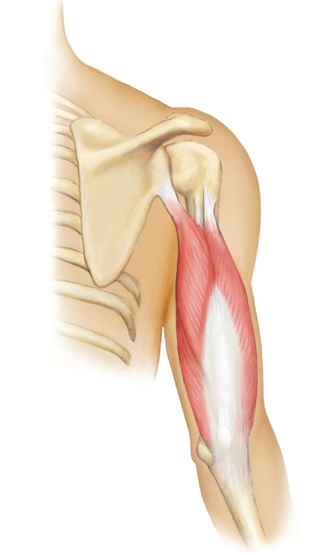
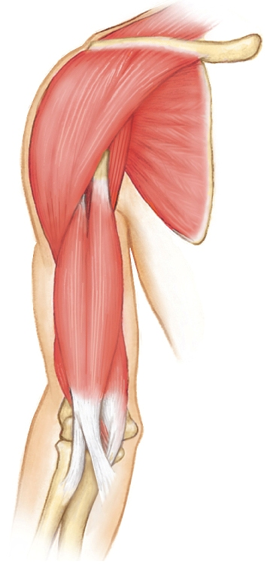
Subscapularis
Biceps brachii
Coracobrachialis
Brachialis
Triceps brachii

Slide 7
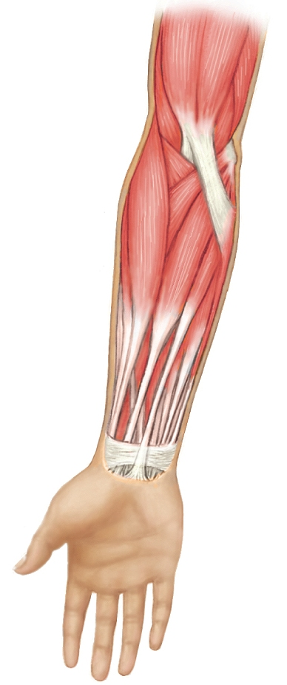
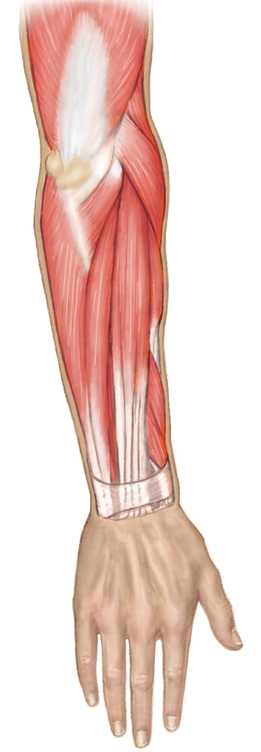
Supinator
Pronator teres
Extensor carpi radialis longus
Brachioradialis
Flexor carpi ulnaris
Extensor digitorum
Palmaris longus
Extensor carpi ulnaris
Flexor carpi radialis

Slide 8
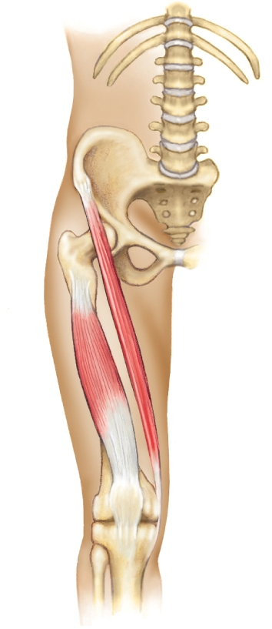
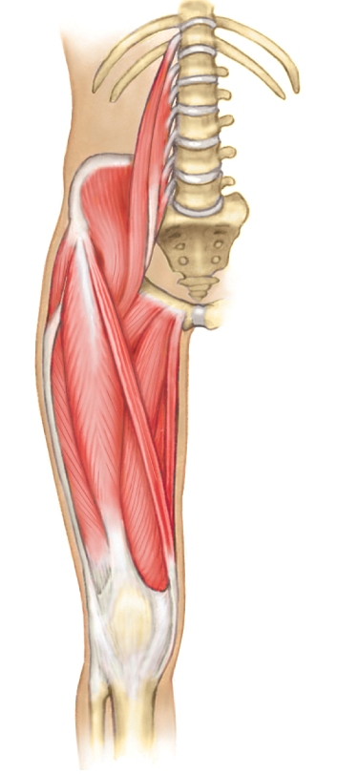
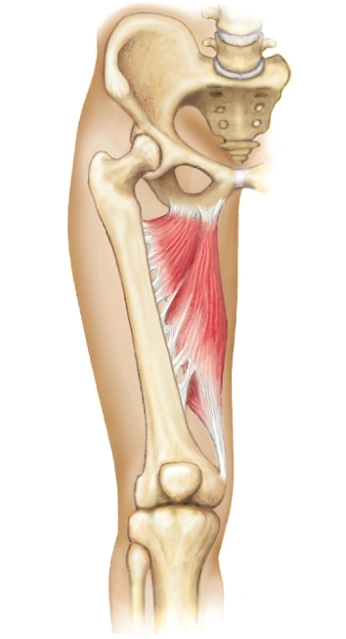
Sartorius
Adductor longus
Gracilis
Rectus femoris
Vastus medialis
Vastus lateralis
Vastus intermedius
Adductor magnus

Slide 9
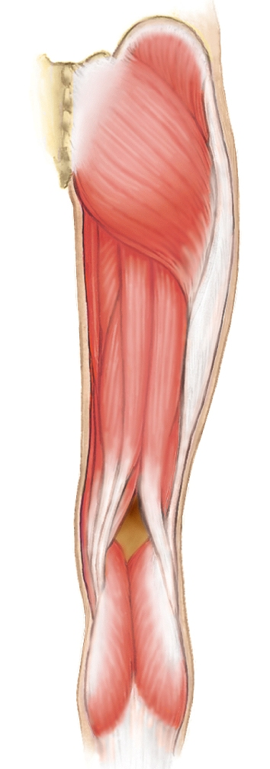
Gluteus medius
Gluteus maximus
Semitendinosus
Biceps femoris
Semimembranosus

Slide 10
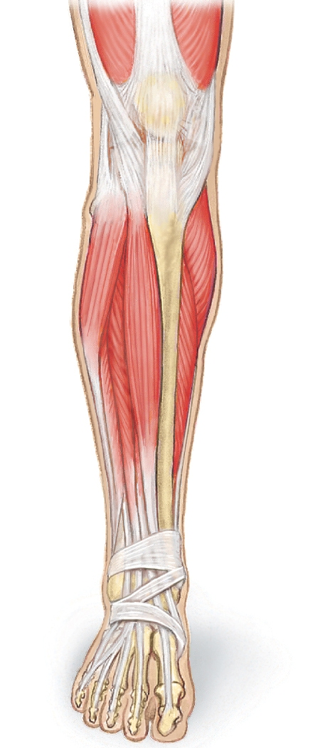
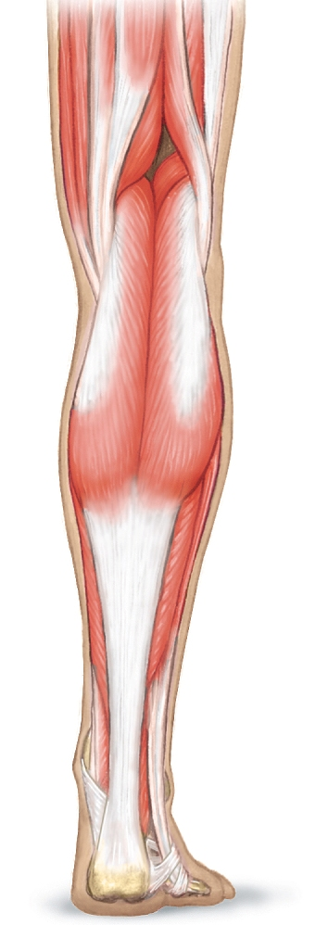
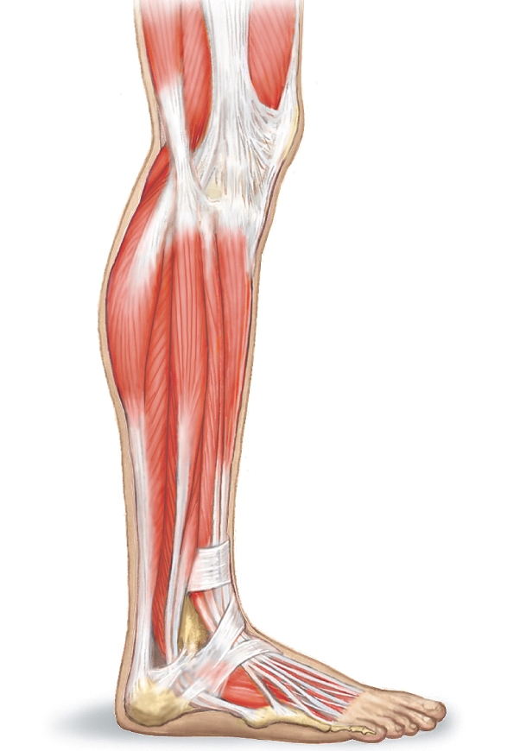
Gastrocnemius
Fibularis longus
Tibialis anterior
Soleus
Extensor digitorum longus

